Slide 1

 | National University of Sciences & Technology (NUST) School of Electrical Engineering and Computer Science (SEECS) Department of Humanities & Sciences
Expository Writing
ENGL-101
Week 5: Lecture # 1
Course Instructor: Dr Samia Tahir
1

Slide 2
How Technology Aids in Brainstorming and Pre-Writing Strategies
Enhancing Idea Generation Through Digital Tools

Slide 3

The Role of Technology in Writing
Technology enhances brainstorming and pre-writing.
Provides visual, AI-powered, and collaborative tools.
Helps organize thoughts and structure ideas effectively.

Slide 4
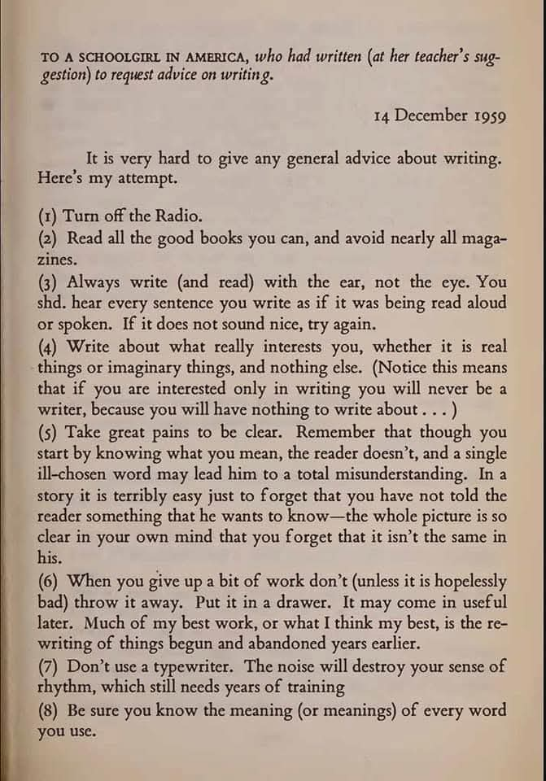

Slide 5
“As new technological tools continue to emerge and impact learning, teachers, students and researchers are facing the question of how to best utilize the vast array of technological tools in the classroom”.

Slide 6

Technology should be balanced judiciously in the pre-writing stages.
Conventional methods cannot be totally ignored as it has its own advantages.
A good teacher should balance and blend the methods.
In the contemporary scenario, it is necessary to have access to a variety of technological assistance to foster an interactive classroom atmosphere and achieve our educational goals.

Slide 7

Avoid using technology just for the sake of using technology.
New technologies should be considered only when it is clear how they can enhance, expand, and/or deepen your brainstorming.

Slide 8
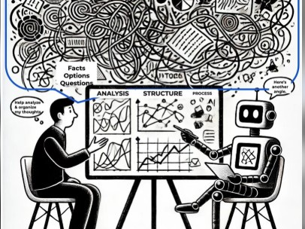

Slide 9
AI in Writing and Pre-Writing
- Tools like Grammarly, ChatGPT, Deepseek and Scrivener.
- Helps refine ideas and ensure coherence.
- Overcomes writer’s block.
- Provides automated suggestions for improvement.

Slide 10
Using Generative AI for Brainstorming
Using generative AI for brainstorming has been a hot topic recently.
Large-language models supercharge ideation via sheer productivity (persistence) and wide semantic breadth (flexibility), yet they also reveal where returns flatten and sameness creeps in.
Here are some takeaways:
Let the model dump ideas until you see originality plateau (around the 500-idea mark in their tests) and only then switch to evaluation.
Deliberately toggle depth vs. breadth. Feed the model with certain data (or have it fetch specific information) to stay focused on facts, then shift to persona prompts (thinking like certain people), or ask models chain-of-thought instructions to ideate more broadly.
Run parallel prompt variations before you merge ideas; otherwise, group trends toward the same “safe” concepts. Use words like ‘unexpected’ or ‘unique’ when prompting helps as well.
Filter ruthlessly -- higher-temperature boosts novelty but also elevates hallucinations.
Final word:
Bottom line: Use the machine to widen the search space, then bring human judgment back to choose, refine, and elevate the best ideas.

Slide 11

Mind Mapping for Idea Generation
Visual organization of ideas.
Helps in creating structured outlines.
Supports logical connections between concepts.
Example of InnovationCloud for remote participants.

Slide 12
Mindly – Collaborative Mind Mapping
Interactive diagrams for idea generation.
Helps structure thoughts efficiently.
Enables team collaboration in brainstorming sessions.

Slide 13
TheBrain – Dynamic Mind Mapping
Creates complex relationships between ideas.
Useful for outlining narratives, research papers.
Visually connects different concepts.
Provides a flexible way to manage interconnected thoughts.

Slide 14
Miro – Digital Whiteboard for Brainstorming
Supports flowcharts, sticky notes, and team collaboration.
Ideal for outlining content visually.
Enhances idea generation in groups.
Offers real-time collaboration with remote teams.

Slide 15

Organizing Research and Key Points
Apps: Evernote, OneNote, Notion.
Enables structured note-taking.
Assists in compiling research materials.
Facilitates easy retrieval of stored information.

Slide 16

Enhancing Team-Based Writing
Tools: Google Docs, Trello, Notion.
Supports sharing and receiving feedback.
Refines writing approach through collaboration.
Allows multiple users to edit in real-time.

Slide 17

Final Thoughts
Technology makes brainstorming more efficient.
Mind mapping, AI, and collaboration tools streamline pre-writing.
Use digital tools to enhance creativity and organization.
Selecting the right tool can improve productivity and idea development.

Slide 18
Activity
Download MindMeister in your phone.
Experience using it by creating a mind map on the topic given below.
The impact of photography on traditional painting.
After creating, share pdf/screenshot of your mind map with the instructor via email.

